Slide 1

R SE to the challenges of ntelligent systems
I
A prediction for future research
Joseph E. Gonzalez
Asst. Professor, UC Berkeley
jegonzal@cs.berkeley.edu

Slide 2
Machine Learning
Big
Data
Training
Big Model
Timescale: minutes to days
Heavily studied ... primary focus of the ML research

Slide 3
Learning
Big
Data
Training
Big Model
Please make a Logo!

Slide 4
Challenges Addressed by the
Data cleaning and preparation
Rich models to isolate complex signals in noisy data
Efficient and scalable learning/opt. algorithms
Tradeoffs between computation, comm., and conv. rates
System support for new algorithms and data-layout

Slide 5
Learning
Big
Data
Training
Big Model

Slide 6
Learning
Inference
Big
Data
Query
Training
?
Decision
Big Model
Application

Slide 7
Inference
Learning
Query
Big
Data
Training
Decision
Big Model
Application
Often overlooked
Timescale: ~10 milliseconds
A focus in the RISELab

Slide 8
Learning
Inference
Big
Data
Query
Training
Decision
Big Model
Application
Feedback

Slide 9
Learning
Inference
Training
Decision
Big
Data
Timescale: hours to weeks
Often re-run training
Another area of focus in RISE
Application
Feedback

Slide 10
Learning
Inference
Big
Data
Query
Training
Responsive
(~10ms)
Adaptive
(~1 seconds)
Decision
Big Model
Application
Feedback
Notes:
Adaptive is hard because of the complex training process that typically revisits the entire data set.
Responsive is hard because of complex often personalized models a elaborate queries

Slide 11
Learning
Inference
Adaptive
(~1 seconds)
Responsive
(~10ms)
The focus of Learning Systems in RISE
Notes:
Adaptive is hard because of the complex training process that typically revisits the entire data set.
Responsive is hard because of complex often personalized models a elaborate queries

Slide 12
Learning
Inference
Adaptive
(~1 seconds)
Responsive
(~10ms)
The focus of Learning Systems in RISE
Notes:
Adaptive is hard because of the complex training process that typically revisits the entire data set.
Responsive is hard because of complex often personalized models a elaborate queries

Slide 13
why is challenging?
Inference
Need to render low latency (< 10ms) predictions for complex
Models
Queries
Features
SELECT * FROM
users JOIN items, click_logs, pages WHERE …
Top K
under heavy load with system failures.

Slide 14
Research in scalable
Inference
Reducing Latency
Approximate caching to address high-dim continuous features
Anytime predictions study the tradeoff between accuracy and time during inference
Model compression to reduce inference costs (memory and CPU)
Improving Throughput
Batching technique to leverage parallel hardware
Model cascades to separate simple and complex queries
System Failures
Graceful degradation as models and resources fail
Abstractions to communicate loss of performance to end-user app.

Slide 15
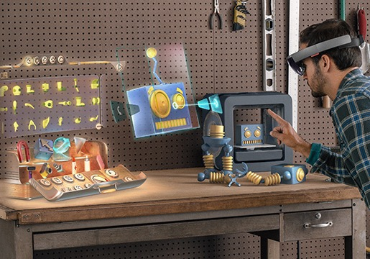

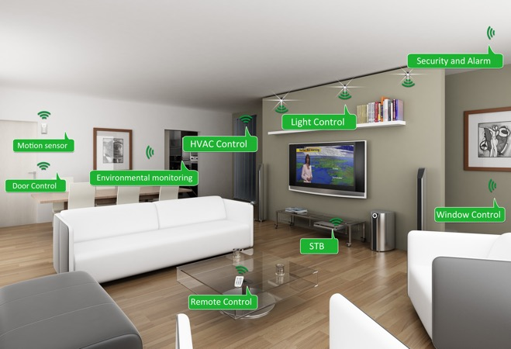
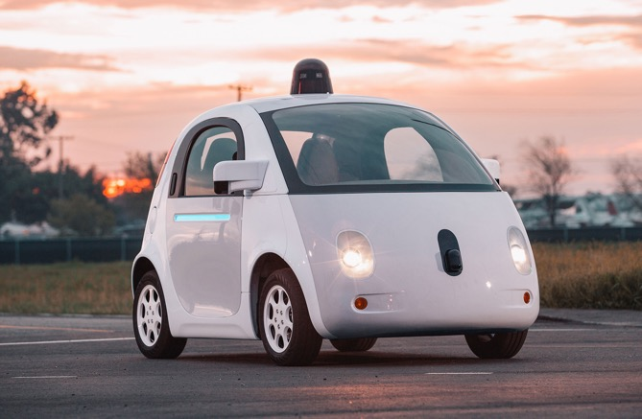
is central to many new apps.
Inference
Augmented Reality
Home Security
Home Automation
Mobile
Assistants
Self Driving Cars
Personal Robotics

Slide 16




is moving beyond the cloud
Inference
Opportunities
Reduce latency and improve privacy
Address network partitions
Research Challenges
Minimize power consumption
Limited hardware & long life-cycles
Protect models from attack
Develop new hybrid models to leverage cloud and devices

Slide 17
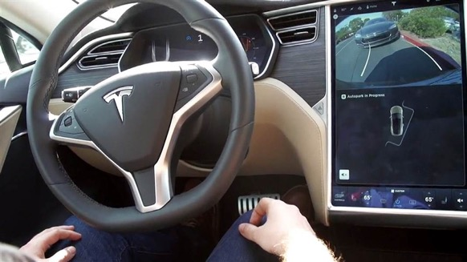
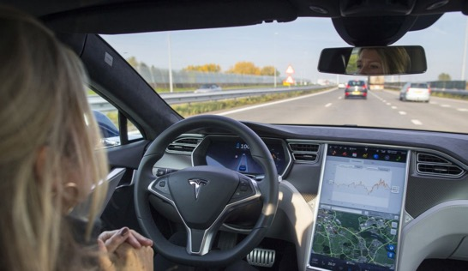
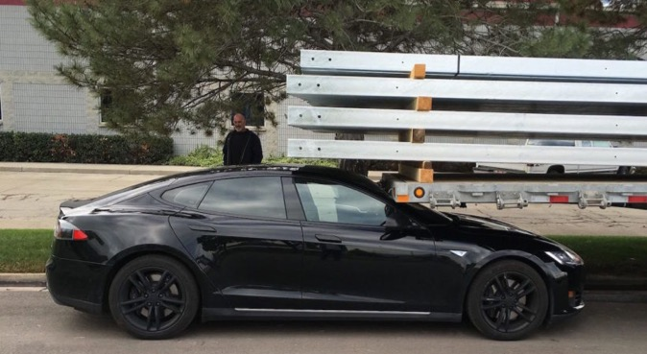
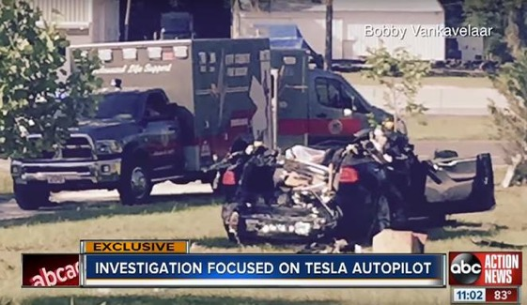
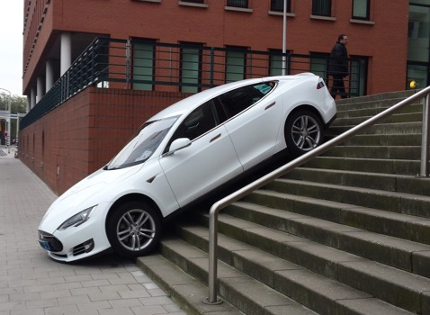
Robust is critical
Inference
Self “Parking” Cars
Self “Driving” Cars
Chat AIs

Slide 18
Research in Robust
Inference
How do we
identify inputs that are outside the domain of the model
nighttime images for a daytime model
recognize poorly performing models without feedback
e.g., feature and label distribution deviates from training data
Calibrate and communicate uncertainty in predictions
e.g., ensembles & CIs → increased overhead …
at scale with rapidly changing models and data?

Slide 19
Learning
Inference
Adaptive
(~1 seconds)
Responsive
(~10ms)
The focus of Learning Systems in RISE
Notes:
Adaptive is hard because of the complex training process that typically revisits the entire data set.
Responsive is hard because of complex often personalized models a elaborate queries

Slide 20
Learning
Inference
Adaptive
(~1 seconds)
Responsive
(~10ms)
Closing the Loop
The focus of Learning Systems in RISE

Slide 21
Why is challenging?
Closing the Loop
Combines multiple systems with different design goals
Latency vs Throughput
Exposes system to feedback loops
If we only play the top songs how will we discover new hits?
Must address concept drift and temporal variation
How do we forget the past and model time directly
Model complexity should evolve with data
Personalization and delayed reward → emphasis on MTL and RL
Learning with complex model dependencies
Robust learning against adverserial data

Slide 22
Feedback and Model Dependencies
How do we:
automatically identify feedback and model dependencies?
distributed learning with bandits: theoretical results → systems
tradeoff comm., conv., & computational overhead
collect sufficient training data for counterfactual analysis
learn with complex dependencies:
Cat Photo
isCat
isAnimal
Cat Classifier
Animal
Classifier
Cute!
Cuteness
Predictor

Slide 23
New Emphasis on MTL and RL
Personalization and Context → Multi-Task Learning (MTL)
e.g., security system that can identify suspicious activity
Limited training data per-house
Many houses with similar tasks but each house is slightly different
Feedback can be sparse and delayed → Reinforcement Learning
e.g., adaptive content
Goal: maximize engagement
Predictions → actions → long-term feedback
Well studied theory meets scalable systems:
challenges: latency, parallel exploration, distributed state management …

Slide 24
Learning
Inference
Adaptive
(~1 seconds)
Responsive
(~10ms)
Security
The focus of Learning Systems in RISE

Slide 25
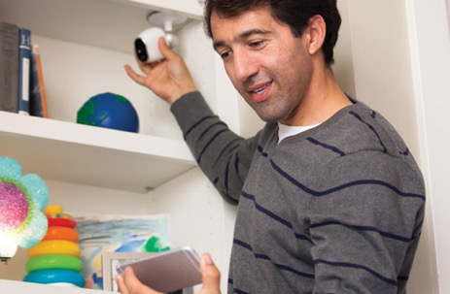
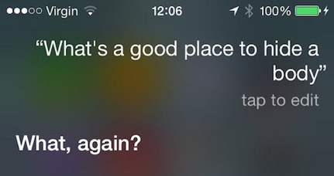
Security: Protecting Queries
Intelligent systems asked to render predictions on sensitive queries.
Protect the query and prediction while hosting models in the cloud.
AR/VR Systems
Home Monitoring
Voice Technologies
Medical Imaging

Slide 26
Security: Protecting Models
Data is a core asset & models capture the value in data
Expensive: many engineering & compute hours to develop
Models can reveal private information about the data
How do we protect models from being stolen?
Prevent them from being copied from devices (DRM? SGX?)
Defend against active learning attacks on decision boundaries
How do we identify when models have been stolen?
Watermarks in decision boundaries?

Slide 27
Learning
Inference
Adaptive
(~1 seconds)
Responsive
(~10ms)
The focus of Learning Systems in RISE
Notes:
Adaptive is hard because of the complex training process that typically revisits the entire data set.
Responsive is hard because of complex often personalized models a elaborate queries

Slide 28

Motivating Example
Home video security systems

Slide 29

Technology
AC Powered Lamp
Commodity ARM processor
720HD Video
Microphone & Speaker
Infrared Motion Sensors
Goals:
Detect, identify, and record people
Notify homeowner and open channel of comm.

Slide 30
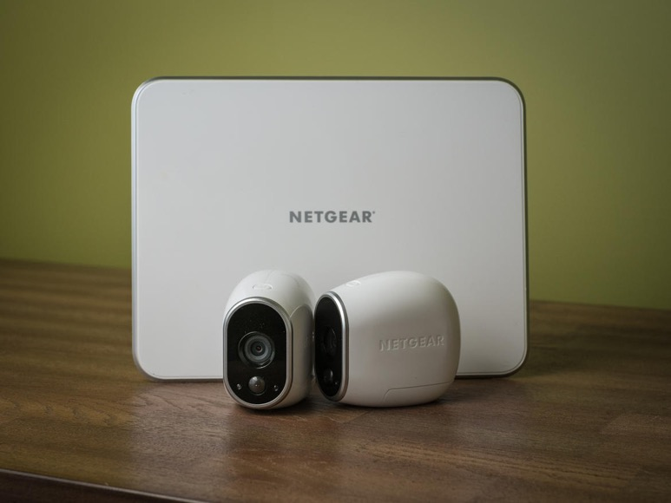
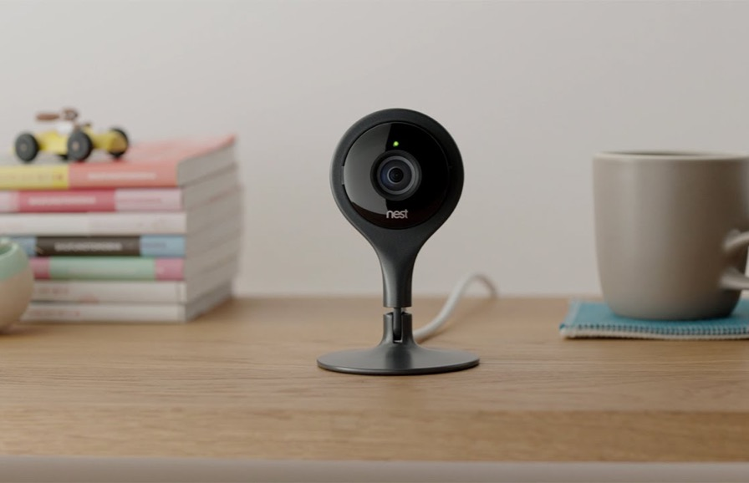
Similar Technologies
Battery Operated Wireless Camera System
Powered
Indoor Wireless Camera System

Slide 31
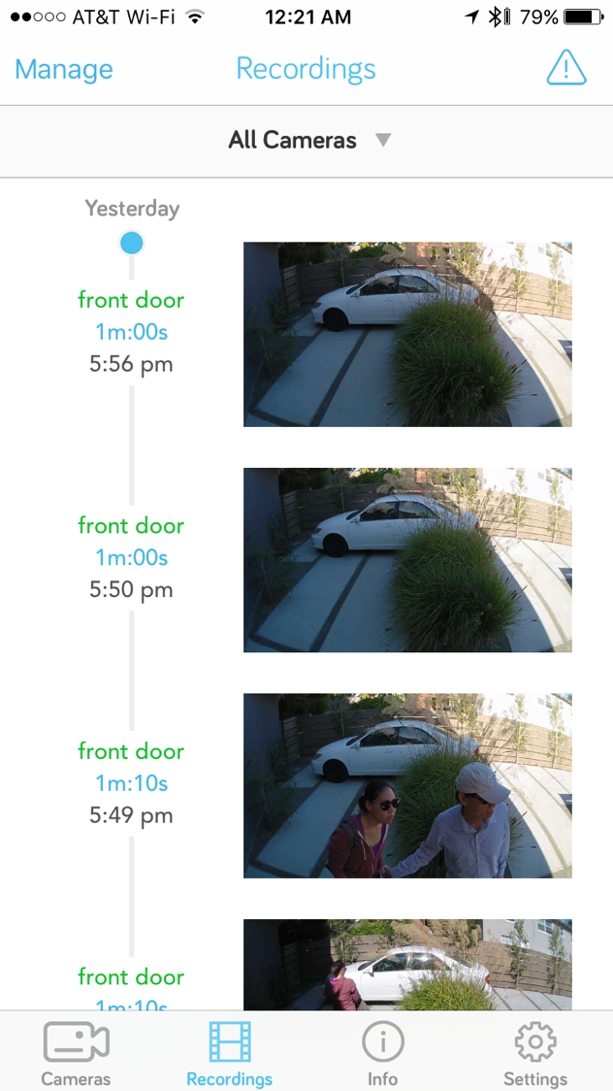

Slide 32
Key challenges
Need to recognize people and notify home-owner in real-time
Package delivery → user must connect to camera and talk to person
Limited, commodity processors on devices
in some cases (Arlo) limited power
Sending video to cloud is expensive: $, power, and bandwidth
Security: Video stream may contain sensitive information
records when you leave …
a camera in every room …

Slide 33
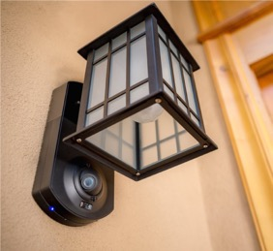
How does work?
Fast onboard pixel-level filter identifies suspicious change
Person1
Key frames are sent to EC2 for further processing
More sophisticated processing to reduce false positives (costly GPU time)
Person1

Slide 34
future technology challenges
Improved on-device classification to reduce false positives that are processed by cloud.
On-device learning to identify user specific patterns
e.g., the shrub in front of my house moves with the wind
More efficient prediction rendering in the cloud
Running full CV pipeline on all images is very costly
Future:
Event characterization: “Package delivery at 1:33 PM”
Automatic user interaction: “Hi can I help you …”
Person1

Slide 35
The focus of Learning Systems in RISE
RISELab
natural progression of research and an exciting opportunity
to address new challenges

Slide 36
RISELab All Hands Options
Goals:
Foster greater collaboration and improve research quality
Give everyone a broad perspective of work in the RISELab
All hands should be enjoyable and rewarding (beyond food)
Presentations on:
topic area overview covering more than one paper
work in progress with emphasis on getting feedback
proposals for new projects and finding collaborations
debates on hot topics in research (competing perspectives)

